Slide 1

STANDARDS:
SS6G8 Explain environmental issues in Europe.
Explain the causes and effects of acid rain in Germany.
Explain the causes and effects of air pollution in the United Kingdom.
Explain the causes and effects of the nuclear disaster in Chernobyl, Ukraine.
© Brain Wrinkles

Slide 2


Europe’s
Environmental
Issues
Acid Rain in Germany, Air Pollution in the United Kingdom, & the Nuclear Disaster in Chernobyl, Ukraine
© Brain Wrinkles

Slide 3
Acid Rain
in
Germany
© Brain Wrinkles

Slide 4
Acid Rain
Over the past 30 years, acid rain has been damaging Germany.
It contaminates soil, kills trees, eats holes in the surfaces of buildings & statues, pollutes rivers, and harms wildlife.
© Brain Wrinkles

Slide 5
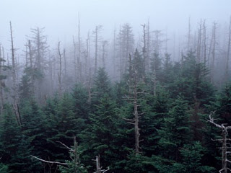
© Brain Wrinkles

Slide 6
What is Acid Rain?
Acid rain is a result of air pollution.
When any type of fuel is burned, a lot of different chemicals are produced and released into the air.
The chemicals mix with water in the clouds and come down with rain.
© Brain Wrinkles

Slide 7
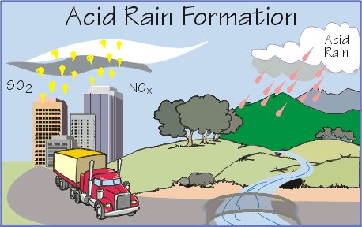
© Brain Wrinkles

Slide 8
What is Acid Rain?
The rain that falls has weak levels of acid mixed in.
It’s not acidic enough to burn your skin, but it is very harmful for the environment.
© Brain Wrinkles

Slide 9

Left Branch shows needle loss and discoloration due to acid rain.
© Brain Wrinkles

Slide 10
Causes
The main source of acid rain is smoke from factories (burning fuels like natural gas, coal, & oil).
Cars and buses also produce harmful gases.
© Brain Wrinkles

Slide 11
Effects
Acid rain can effect trees in several different ways.
It dissolves & washes away the nutrients and minerals in the soil.
It also causes the release of harmful substances such as aluminum into the soil.
© Brain Wrinkles

Slide 12
Black Forest
Acid rain has destroyed nearly half of the Black Forest in Germany!
This has really harmed Germany’s economy because one of its major natural resources is timber.
© Brain Wrinkles

Slide 13
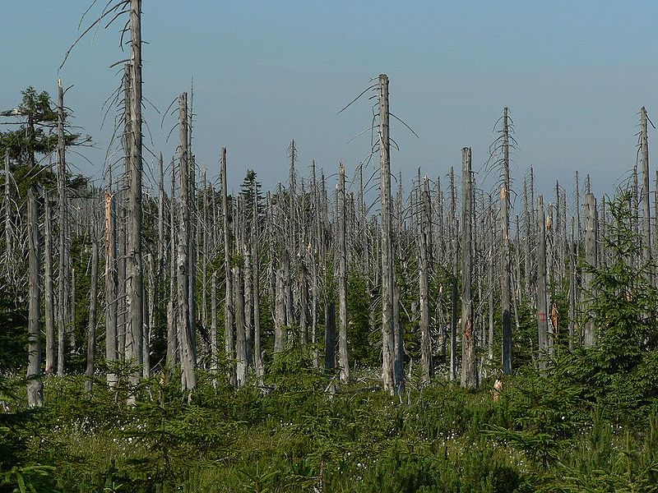
© Brain Wrinkles

Slide 14
Effects
Acid rain causes the water in rivers and lakes to become more acidic.
  Fish and other animals that live in these waters are dying, as well as the animals that drink from these waters.
It also causes people to face harmful health hazards because the rain contaminates the drinking water in fresh water reservoirs.
© Brain Wrinkles

Slide 15
Effects
Nitrogen and sulfur in acid rain are eating away at many of Germany’s landmarks, causing buildings and artwork to deteriorate.
Concrete, metals, limestone, and marble are all susceptible to acid rain, and many of Germany’s cultural objects that are hundreds of years old are slowly corroding away.
© Brain Wrinkles

Slide 16
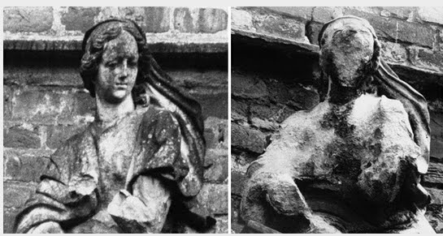
Acid Rain Can Cause Erosion in Stone Statues & Buildings
© Brain Wrinkles

Slide 17
Germany’s
Solution
In Germany, power plants that use water power are replacing many coal-burning factories.
They are developing new types of energy, such as wind turbines and solar power.
Germany’s government has passed laws to reduce emissions from cars and factories.
© Brain Wrinkles

Slide 18
Air Pollution
in the
United Kingdom
© Brain Wrinkles

Slide 19
Air Pollution
Many of the world’s largest and most industrialized countries are in Europe.
  Paris, London, Berlin, Rome, Amsterdam
These cities tend to have a lot of factories, a lot of traffic, and produce a lot of air pollution.
A country that has been greatly effected by this problem is the UK.
© Brain Wrinkles

Slide 20
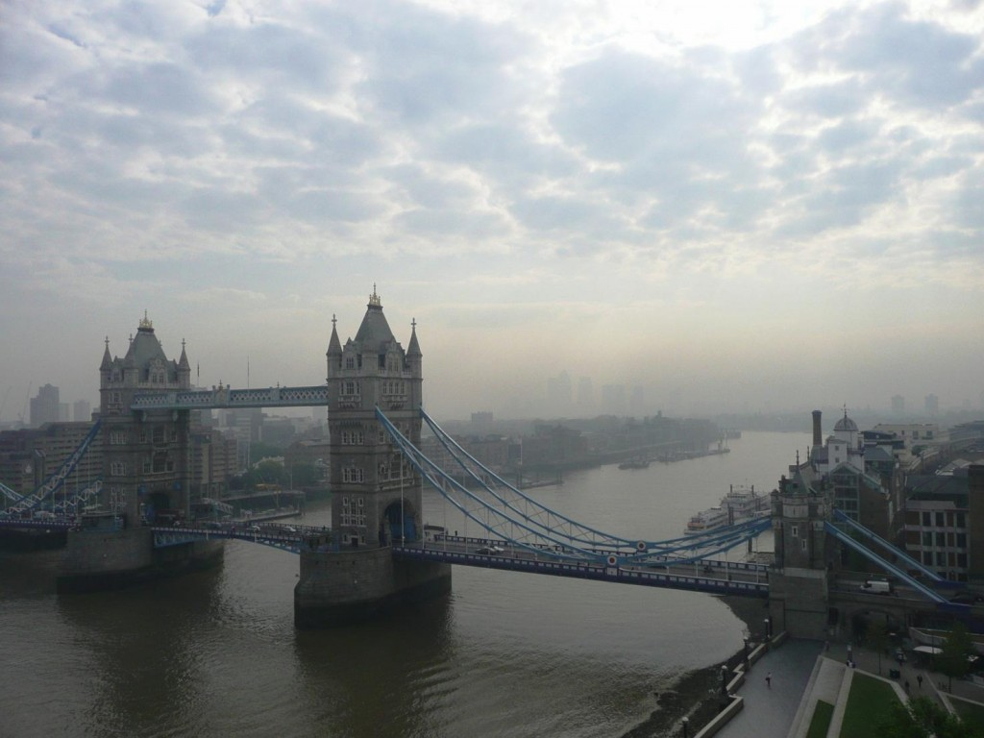
© Brain Wrinkles

Slide 21
UK’s Air Pollution
London, the capital of UK, is famous for air pollution.
The word “smog” was first used in 1905 to describe air in London (thick fog + smoke).
Thick London smog happens when sunlight acts on the gases from factory or automobile exhausts, or when water in the air mixes with smoke particles.
© Brain Wrinkles

Slide 22
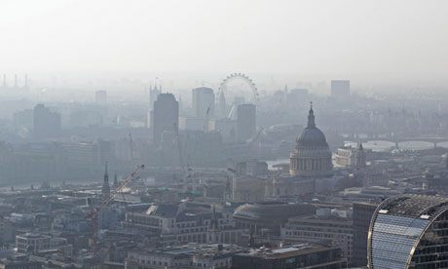
© Brain Wrinkles

Slide 23
Causes
In the past, the major source of air pollution was smoke from burning coal in factories.
The air quality in the UK began diminishing due to the smoke and air pollutants emitted from the burning coal.
© Brain Wrinkles

Slide 24
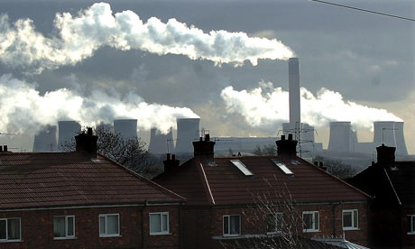
© Brain Wrinkles

Slide 25
Causes
Today, exhaust from automobiles is the big problem.
Emissions from automobiles contain carbon monoxide and nitrous oxide, which stay close to the ground and contribute to low-lying smog.
© Brain Wrinkles

Slide 26
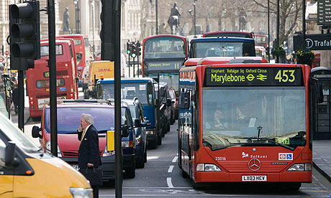
© Brain Wrinkles

Slide 27
Effects
Asthma and pneumonia are linked to vehicle emissions.
Air pollution burns the lungs, nose, and eyes, and endangers human life.
When air pollution levels are high, children, sick people, and the elderly have to stay inside to avoid breathing the hazardous air.
© Brain Wrinkles

Slide 28
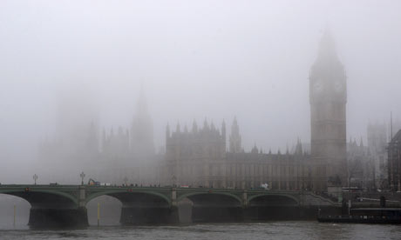
© Brain Wrinkles

Slide 29
Effects
Air pollution also harms vegetation.
Vegetation exposed to polluted air for long periods of time grows more slowly and is more susceptible to disease and insects.
This causes a major decrease in crop production.
© Brain Wrinkles

Slide 30
UK’s Solution
Starting in the 1950s, UK’s government has created smokeless zones in London where only smokeless fuels could be used.
Electricity has also been used more in factories and homes.
Laws have been created that require automobile makers to build cars that produce less exhaust.
People have been asked to drive less and are encouraged to use public transportation or walk.
© Brain Wrinkles

Slide 31
What is Europe
doing to fix
these problems?
© Brain Wrinkles

Slide 32
Environmental
Policies
In Western Europe, nations are trying to lessen pollution.
  They are spending money and researching new ways to produce power that cause less environmental damage.
In Eastern Europe, few nations are researching new technologies.
  They have less money.
© Brain Wrinkles

Slide 33
European Union
Most countries in Europe are members of a group called the European Union.
Since its formation in 1993, the EU has passed policies designed to fight acid rain, improve air quality, restrict toxic waste, and reduce pollution.
© Brain Wrinkles

Slide 34
Nuclear
Disaster
in
Chernobyl,
Ukraine
© Brain Wrinkles

Slide 35
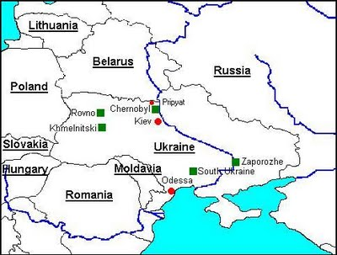
© Brain Wrinkles

Slide 36
Nuclear Power
Between 1922 and 1991, Ukraine was part of the Soviet Union and was known for its fertile farmland and successful agricultural industry.
During the 1980s, many countries in Europe began using nuclear power plants to produce cleaner and cheaper energy in order to rely less on fossil fuels.
© Brain Wrinkles

Slide 37
Nuclear Power
Many European countries had strict regulations on nuclear power use; however, Ukraine did not.
Chernobyl was a growing city in Ukraine, and it was home to the largest nuclear power plant in Europe.
Unlike other nuclear power plants, Chernobyl was used to produced nuclear weapons material.
© Brain Wrinkles

Slide 38
Chernobyl
In 1986, the Soviet Union generated 10% of the world’s nuclear power.
On April 26, 1986, one of the reactors at the Chernobyl nuclear power plant exploded.
The explosion released large amounts of deadly radioactive nuclear material into the atmosphere.
© Brain Wrinkles

Slide 39
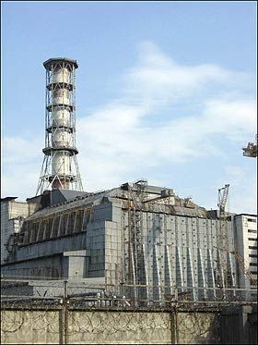
Before…
© Brain Wrinkles

Slide 40
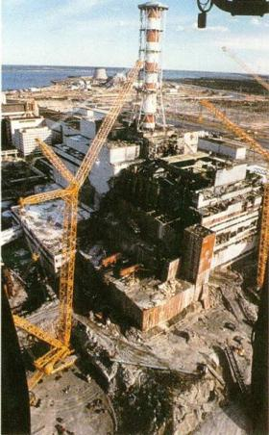
After
© Brain Wrinkles

Slide 41
Soviet Reaction
The morning after the explosion, there was no hint of a disaster.
After 36 hours of being exposed to radiation, the people were finally told to pack their clothing and evacuate their homes.
There was a 18 mile evacuation zone.
© Brain Wrinkles

Slide 42
Worldwide Impact
Nearly nine tons of radioactive material (90 times as much as the Hiroshima bomb) was hurled into the sky.
Over the following days, winds mostly blowing north and west, carried fallout into Belarus, as well as Russia, Poland, & other countries around the world.
© Brain Wrinkles

Slide 43
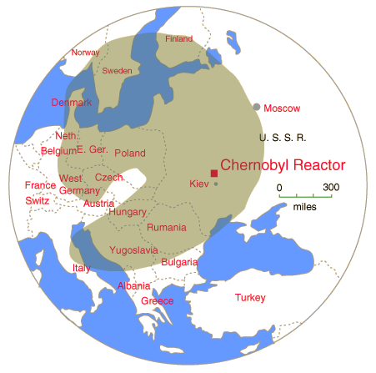
© Brain Wrinkles

Slide 44
Effects
In the first months after the accident, 28 emergency workers died from acute radiation syndrome.
  Doctors have noticed an increase in cases of cancer who lived nearby.
Many animals died or got sick.
  Fish in nearby rivers were unsafe to eat for many years.
Millions of acres of farmland have been poisoned.
© Brain Wrinkles

Slide 45
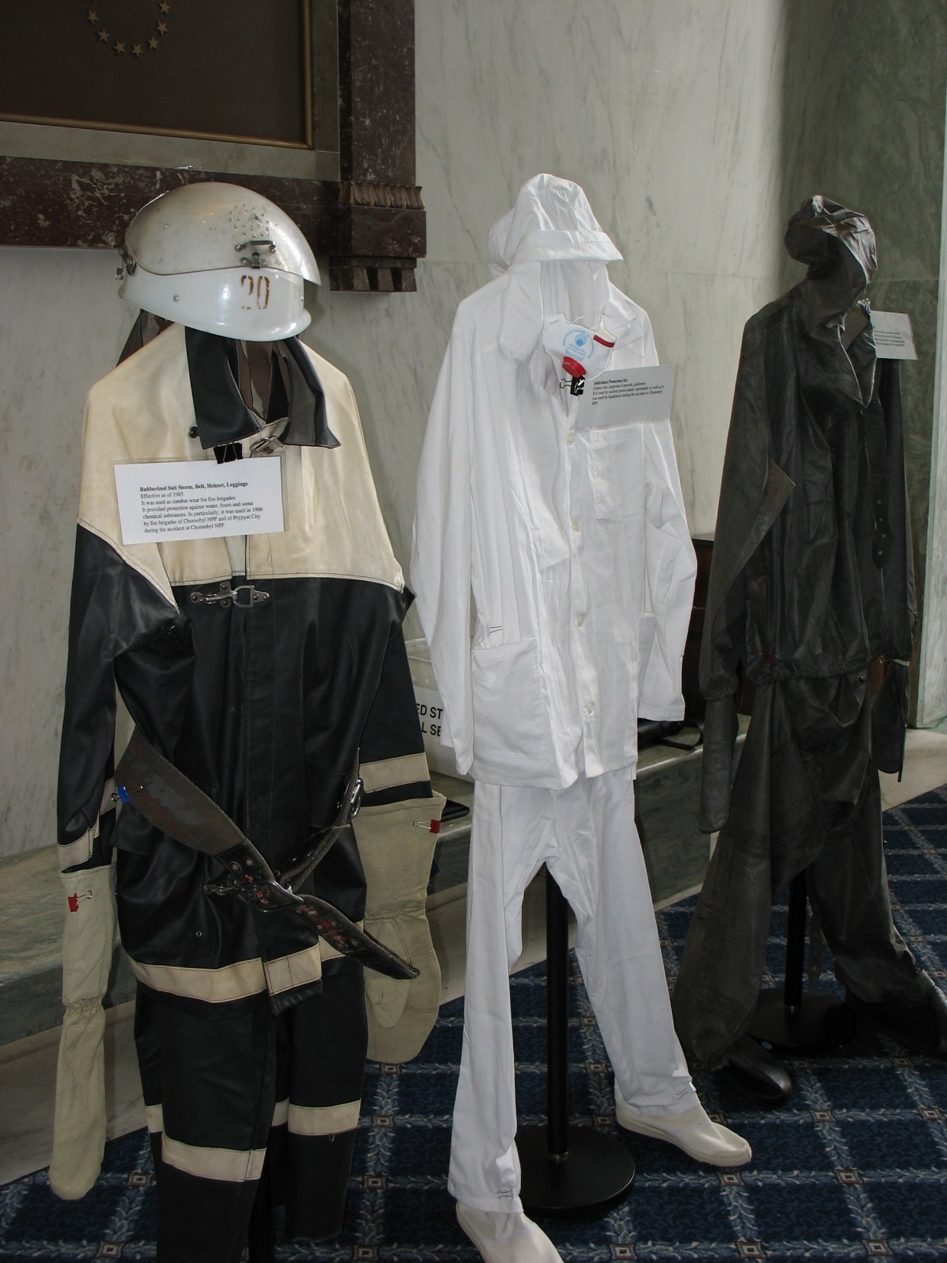
Radiation Suits Worn By Workers
© Brain Wrinkles

Slide 46
Effects
The people exposed to the high levels of radiation developed a high level of health problems, including thyroid cancer, autoimmune disorders, birth defects, and other health issues.
© Brain Wrinkles

Slide 47
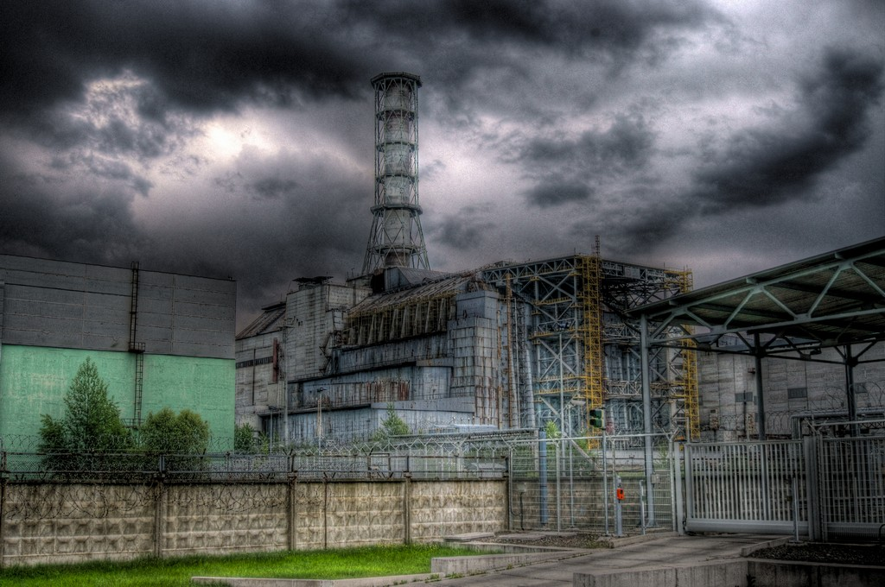
© Brain Wrinkles

Slide 48
Chernobyl Today
Chernobyl continued to produce electricity for another 14 years, until international pressure forced its closure in 2000.
An official exclusion zone around the plant remains in place, extending for 18 miles.
It is one of the most radioactive spots on Earth.
© Brain Wrinkles

Slide 49
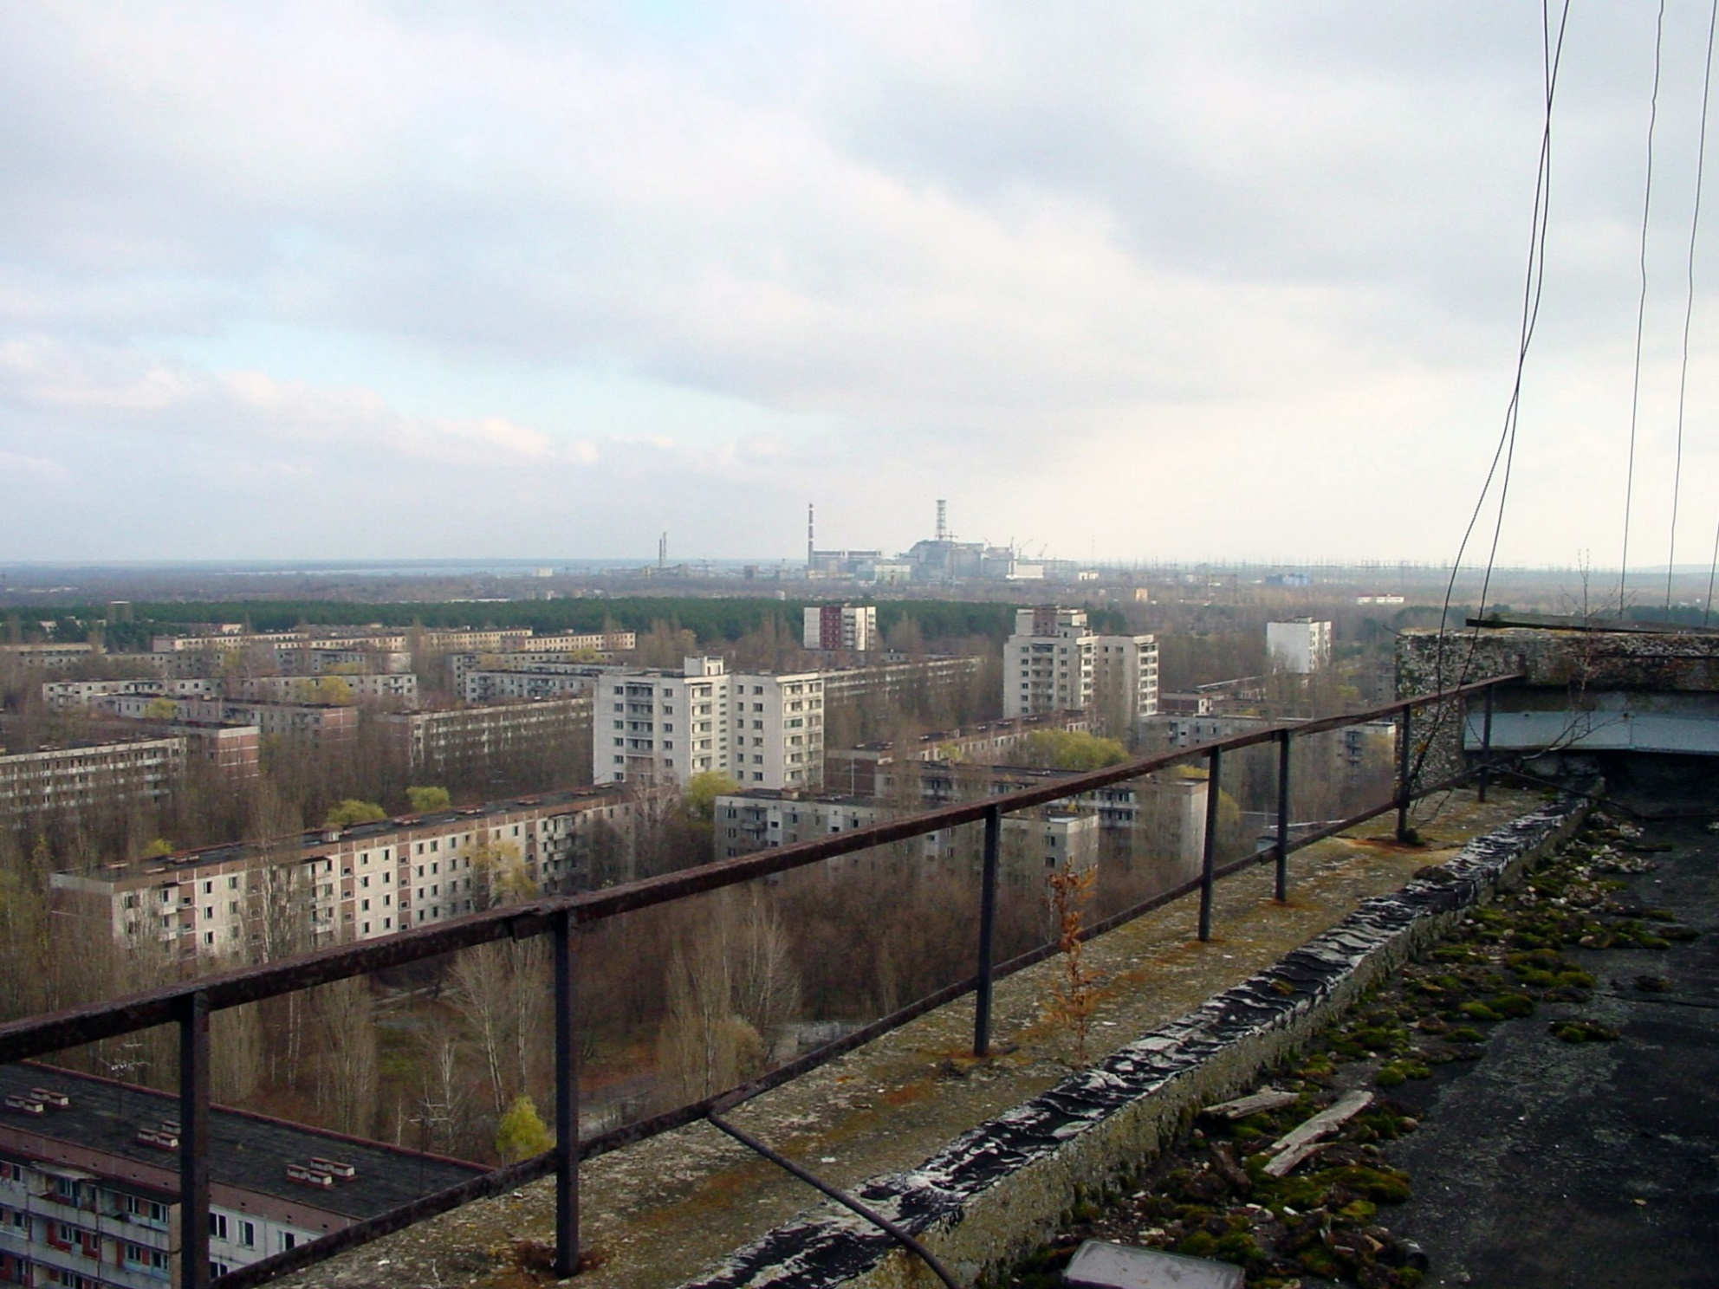
Chernobyl Today…A Ghost Town
© Brain Wrinkles

Slide 50
Chernobyl Today
In 2011, Ukraine opened up an area so tourists can see first-hand the effects of the disaster.
Forests surrounding the city have repopulated with a variety of wildlife and vegetation.
Radiation levels are still so high that humans cannot live here for 20,000 years!
© Brain Wrinkles

Slide 51
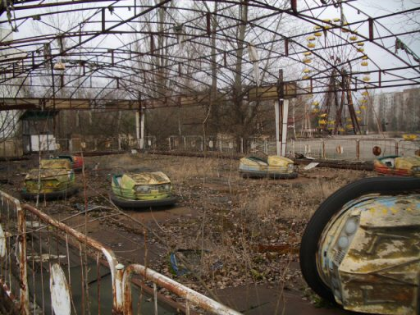
Amusement Park
© Brain Wrinkles

Slide 52
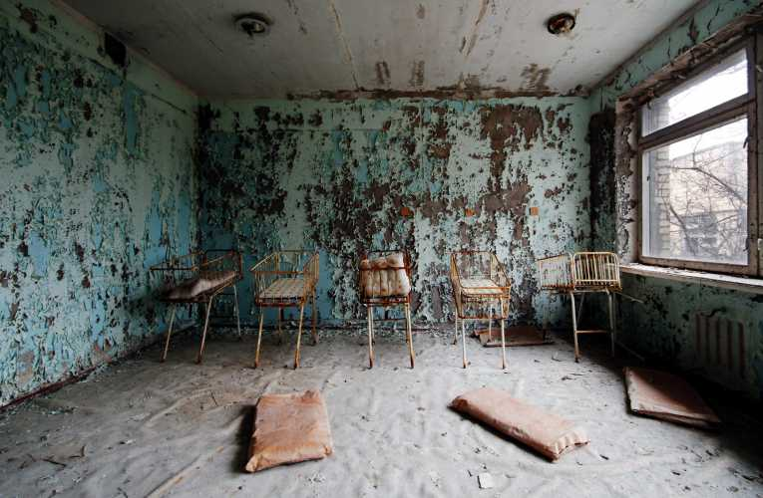
Hospital (Baby Room)
© Brain Wrinkles

Slide 53
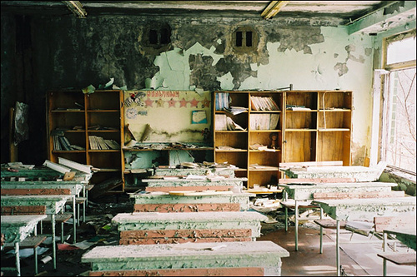
School Classroom
© Brain Wrinkles

Slide 54
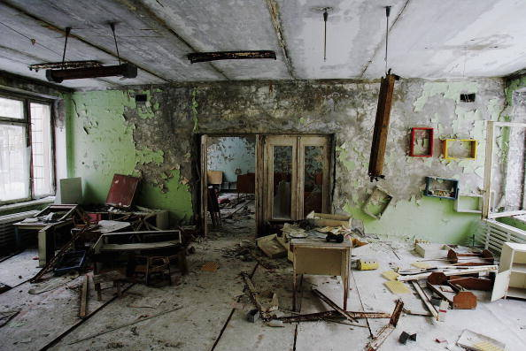
School Classroom
© Brain Wrinkles

Slide 55
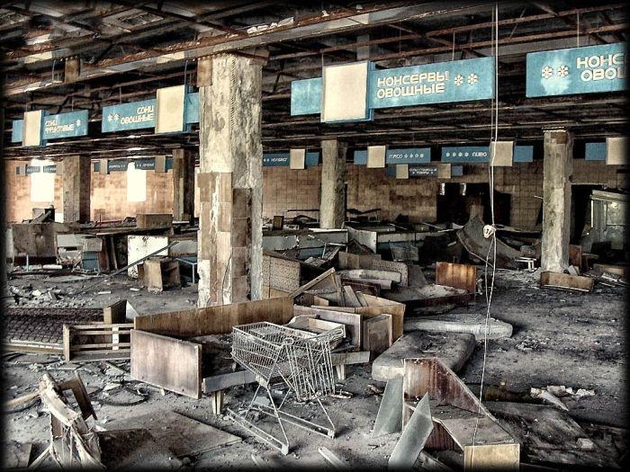
Grocery Store
© Brain Wrinkles

Slide 56
© Brain Wrinkles
ILLUSTRATION
SOLUTION
EFFECTS
CAUSES
Acid Rain in Germany
Directions: Complete the chart below with information that you learn during the presentation. If time allows, color your illustrations.
Europe’s Environmental Issues
Air Pollution in the United Kingdom
Nuclear Disaster in Chernobyl, Ukraine

Slide 57

The
SMOG BLOG
Post Title & Date
Author (You)
Write a blog post as if you are a tourist that is visiting at least one of the sites of the environmental issues we discussed. Use descriptive words to describe how the issue is impacting the location based on what you are “seeing”.
.
About
the
Author…
Post Body:
2 other popular post titles by the author (related to this lesson)
Significant Photo:
© Brain Wrinkles

Slide 58
The
SMOG BLOG
© Brain Wrinkles

Slide 59
Name:
Name:
Design an App
Design an App
Design the logo for a new app that will solve one of Europe’s environmental issues. Also, write a description about what the app does and how it will work to fix the issue.
Design the logo for a new app that will solve one of Europe’s environmental issues. Also, write a description about what the app does and how it will work to fix the issue.
© Brain Wrinkles
© Brain Wrinkles

